Slide 1
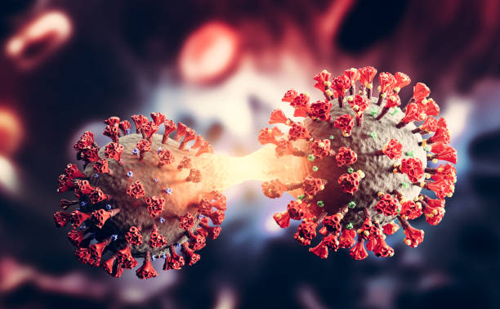

COVID-19 DAILY CASES INTERNCAREER INTERNSHIP PROJECT 2
JOY CHINENYE AKOUWA

Slide 2
Project Plan
Overview
Dashboards
Insights
Recommendation
Conclusion

Slide 3
Overview
This analysis delves into the global landscape of COVID-19 daily cases, exploring key metrics such as total confirmed cases, recoveries, deaths, vaccination statistics, demographic insights, and regional impacts.
The project aims to provide a comprehensive understanding of the pandemic’s progression, vaccine distribution, and demographic factors influencing the spread and impact of the virus.

Slide 4
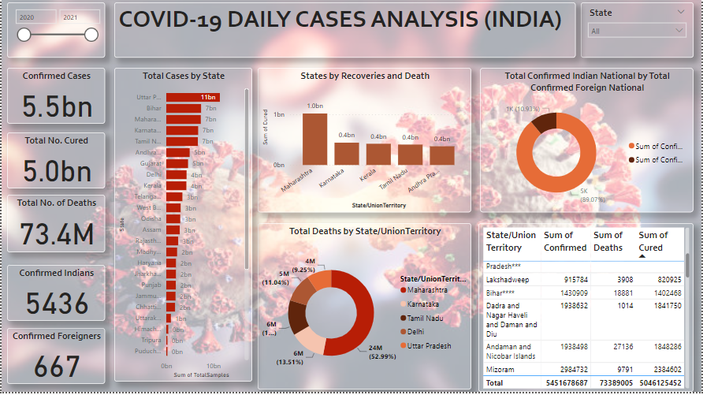
Dashboard

Slide 5
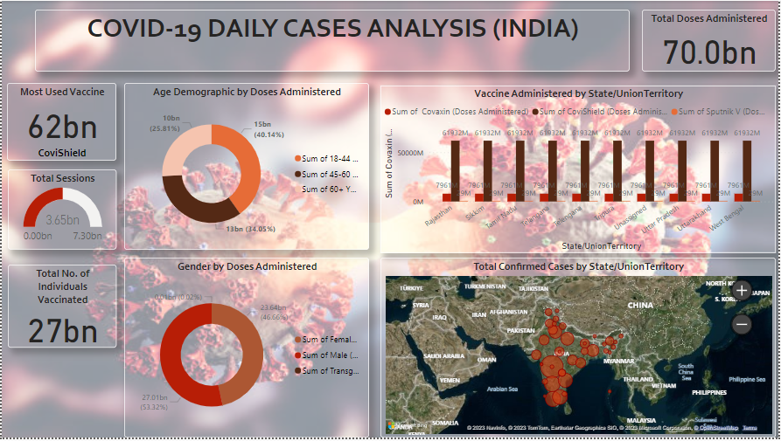
Dashboard

Slide 6
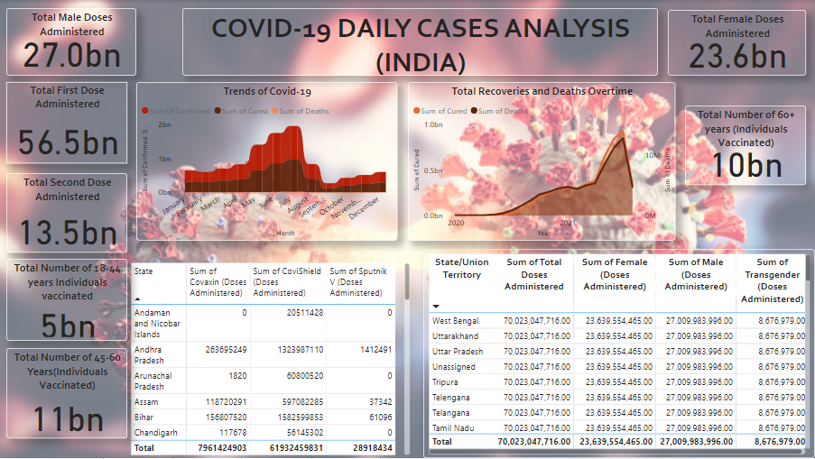
Dashboard

Slide 7
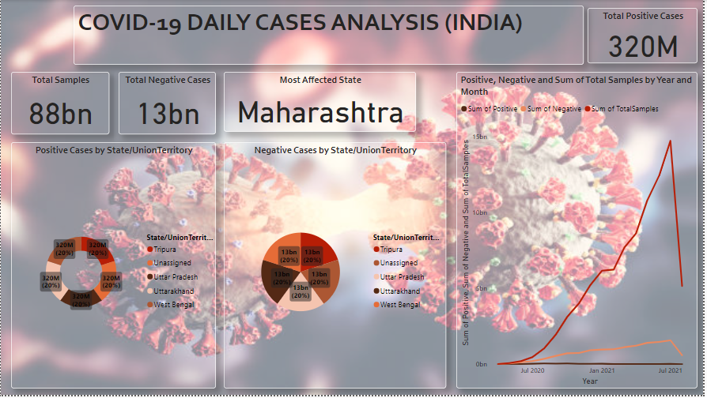
Dashboard

Slide 8
Insights
Total Confirmed Cases: 5.5 billion cases were reported globally.
Total Number of Cured: 5.0 billion individuals have successfully recovered.
Total Number of Deaths: Tragically, 73.4 million lives have been given.
Total Confirmed Indian Cases: 5,436 cases reported.
Total Confirmed Foreigners Cases: 667 cases documented.
Total Vaccine Doses Administered: 70 billion vaccine doses have been given.
Total Number of Individuals Vaccinated: 27 billion people have received at least one dose of the vaccine.
Most Used Vaccine: CoviShield is the predominant vaccine, with 62 billion doses administered.
Most Vaccinated Age Group: Ages 45-60 account for the highest vaccinated rate at 11 billion.

Slide 9
Insights
Vaccine Dosage by Age:
18-44 years: 14%, 45-60 years: 35.05%,
61+ years: 25.85%
Vaccine Dosage by Gender:
Male: 53.32%, Female: 46.66%, Transgender: 0.02%
Total CoviShield Doses: 61.9 billion doses administered.
Total Covaxin Doses: 8.0 billion administered.
Total Sputnik Doses: 29 billion doses given.
Total Number of Positive Cases: 320 million cases have tested positive.
Total Number of Negative Cases: 13 billion cases tested negative.
Total Number of Samples: A staggering 88 billion samples have been analyzed.
Most Affected State: Maharashtra emerges as the most affected state.
July Records: July marks the highest number of confirmed cases, recoveries and deaths.

Slide 10
Recommendations
Intensify vaccination efforts, in regions with lower coverage.
Strengthen public health infrastructure for efficient testing and treatment.
Implement targeted measures in highly affected areas to curb the spread.
Continue monitoring and adapting vaccination strategies based on demographic trends.

Slide 11
Conclusion
The analysis underscores the global impact of the COVID-19 pandemic, emphasizing the importance of widespread vaccination, regional interventions, and continuous monitoring to navigate and eventually overcome this public health crisis.

Slide 12
THANK YOU

